Slide 1

Advanced Web Technologies Docker & OOP
#3
ISEP : Docker & OOP

Slide 2
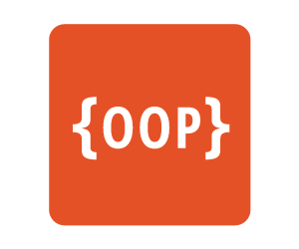
Object-Oriented Programming
Encapsulation
Containing properties and methods inside an object
Inheritance
Propagating behavior to subclasses and eventually override it
Polymorphism
Calling different behaviors with one syntax
ISEP : Docker & OOP

Slide 3


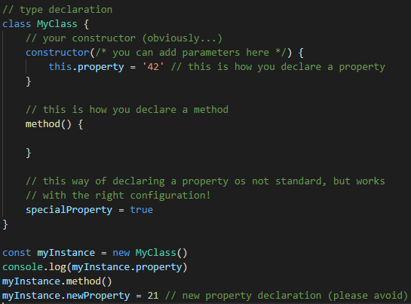
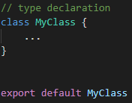
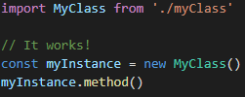
Encapsulation
Constructor is always called constructor
Properties
Methods
Everything is public, no private or protected
ISEP : Docker & OOP

Slide 4
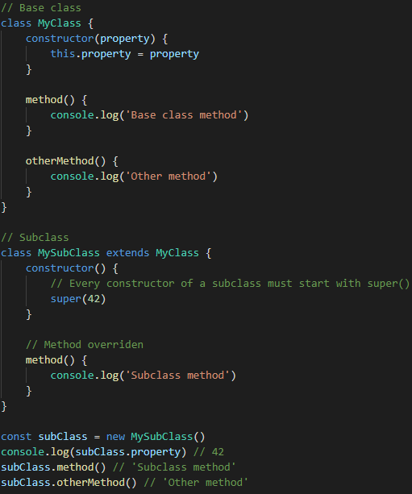
Inheritance & Polymorphism
Inherit with extends keyword
No multiple inheritance
Everything is virtual
So inheritance polymorphism always applies!
No abstract classes or interfaces!
ISEP : Docker & OOP

Slide 5
Design Patterns
What and Why?!
The « best » way to solve a very specific problem
They are well known
They are safe
Creational
Structural
Behavioral
Architectural
Singleton
Factory
Abstract Factory
Composite
Adapter
Decorator
Strategy
Visitor
Command
MVC
MVVM
IoC
ISEP : Docker & OOP

Slide 6
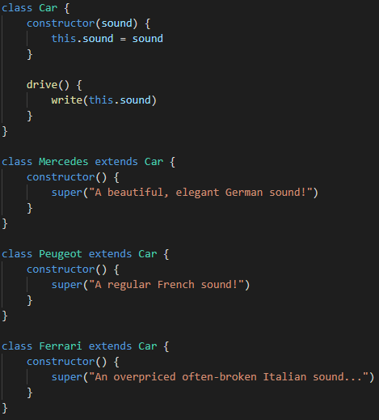
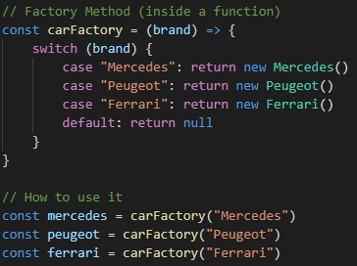
Factory Method pattern
One of the easiest Design Pattern
And one of the most useful ones!
ISEP : Docker & OOP

Slide 7
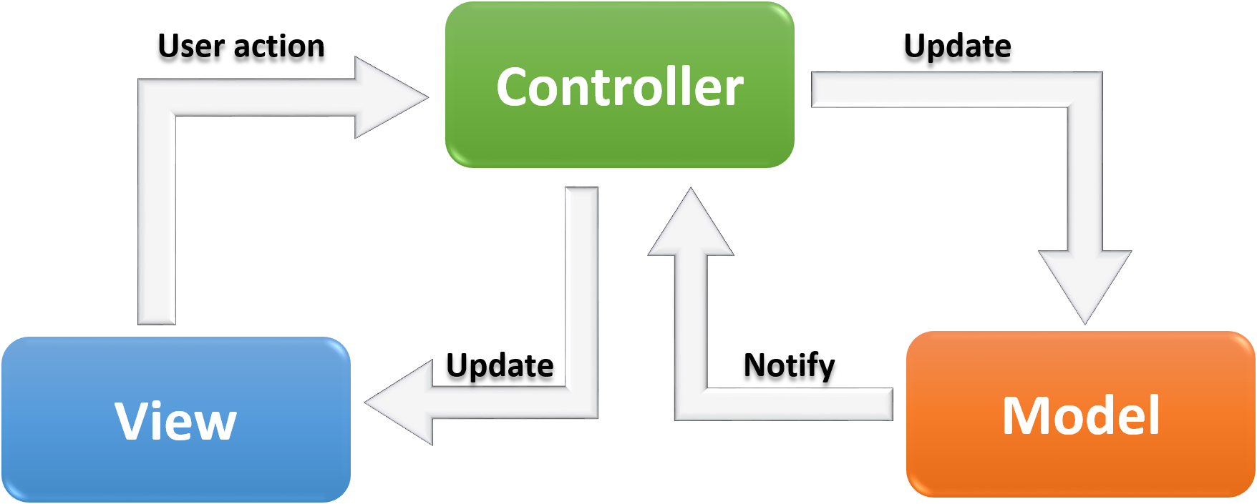
Model-View-Controller pattern
Model: your data, plain and simple
View: what the user sees
Controller : what links your view to your model
ISEP : Docker & OOP

Slide 8

Today’s TP!
What you will have to do:
Santa Claus needs your help to prepare Christmas: he wants a website to manage his dwarf working on presents before sending them to the children!
What will be evaluated:
Implemented features
Code/conception quality
Design
You are allowed to use these libraries (using NPM):
bootstrap
jquery
ANY OTHER LIBRARY IS FORBIDDEN!!!
ISEP : Docker & OOP

Slide 9

That’s finally it! Have fun ☺
#3
ISEP : Docker & OOP

